Slide 1
Tuning MapReduce
Jay Urbain, PhD

Slide 2
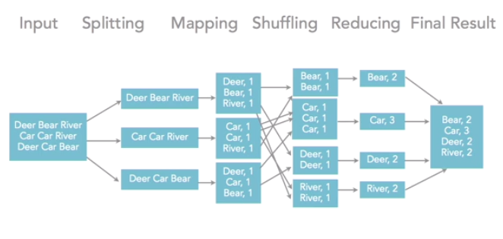
Tuning by physical methods

Slide 3
Better MapReduce: Optimizations
Optimize before job runs
Preprocessing on data, files size, compression, encryption
Optimize onload of the data
Change compression ratio (sequence input), different size chunks
Optimize the map phase of the job
Code, hashing, use Combiner
Optimize shuffle phase of the job
Get better distribution on shuffle-sort, write your own Partitioner
Optimize the reduce phase
Additional transformation, combine or separate aggregations
Optimize after job completes
Partition job into separate jobs, pipeline
Other
Make sure you verify your cluster parameters especially for nonstandard configurations
Unused resources
Overstressed resources – spill out to disk – use cluster-monitoring tools, e.g., Ganglia
Add more nodes – especially when you’re using cloud
Mixed local and cloud Hadoop

Slide 4
Understanding MapReduce
Map
(k1, v1): input information
(k2, v2): intermediate values (one list per node)
can use combiner (mini-Reducer in Mapper) before emitting intermediate values
Shuffle/sort
Reduce
(k2, list(v2))
(k3, v3)
Notes:
Keep jobs as simple as possible, consider adding steps
One type of activity at a time

Slide 5
Mapper Task Optimization
Sub-divide tasks
Chain jobs
1-3 minutes per map task run
Custom partitioner
Default is hash partitioner
Reduce the amount of data
skip unnecessary or bad data, add counter, partition input files
Logging and counters
Monitor/tune for optimal spill ratio
Local Reducers/ combiners
Set Map-only jobs
Photo processing – no aggregation needed

Slide 6
Input file compression
Vendor implementations differ
Read the documentation
Cloudera’s version of LZO is ‘splitable’
Use best from vendor for app

Slide 7
Data Types
Custom types supported – write RawComparator
Custom comparator
E.g. geospatial data
Custom input split
Custom partitioner
Use the Text type only when you are using text data

Slide 8
Reducer Task Optimization
Subdividing tasks (chaining jobs)
Logging/debugging to see what’s going on
Secondary sort
Set thresholds
May not need a Reducer (Map only)
Photos, music, transformation only apps
Reduce data in Mapper

Slide 9
Creating a Distributed Cache
Used to cache files at nodes needed to run application jobs
Include the path via URL’s (hdfs:// ir http://) in JobConf settings
Files will be copied to each data node on job execution
E.g.:
Using a lookup file for translation, black list, white list
Translate numeric code to human values

Slide 10
Summary
Add more nodes
Especially in cloud environment
Distributed cache
Skipping bad records
Subdividing tasks
Logging/profiling
Debugging, unit testing
Optimized Java processing
String manipulation can be a bottleneck
StringBuffer.append
LongWritable and BytesWritable are faster than text parsing

Slide 11
Review
Which of the following is a Mapper Task Optimization?
Subdivide tasks
All of the answers
Reduce the amount of data
Monitor/tune for optimal spill ratio
Creating a distributed cache is important for optimization; it is used to cache files like text files, archives, and JAR files that are needed to run applications or jobs
True
False

Slide 12
Review
Reducer task optimization usually falls into four categories: subdivide tasks, logging/debugging, secondary sort, and setting thresholds
True
False

